Slide 1


Slide 2
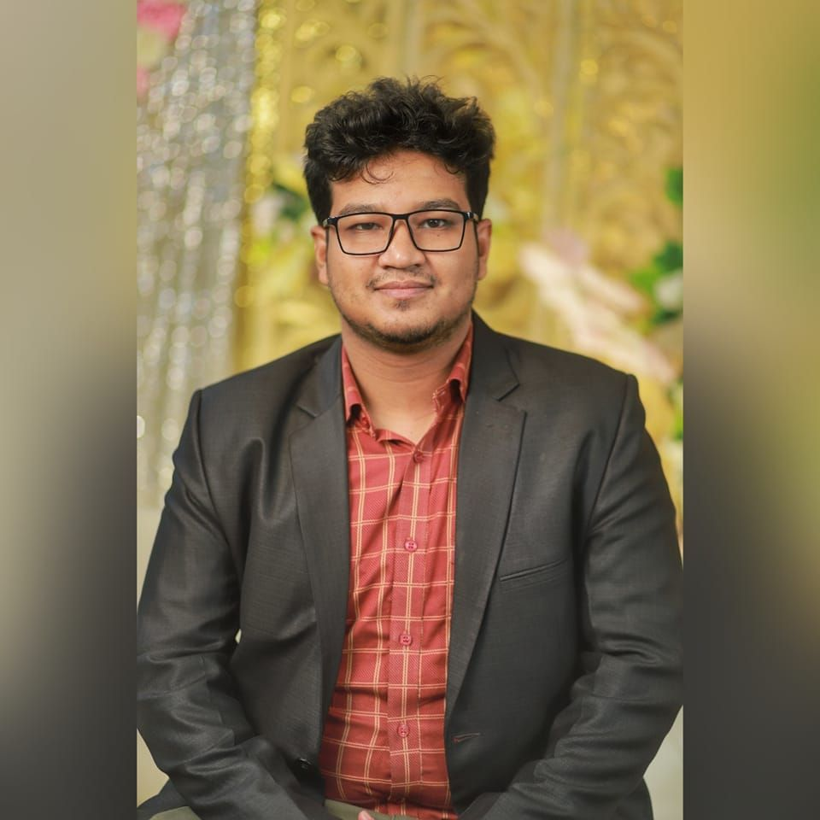
Rajshahi, Bangladesh
Soykot Hosen
Founder & CEO, Code Studio | CTO, Link&Win
soykot.ruet.cse@gmail.com | +8801784286885

Slide 3
We build Mobile App & Website for Business and Startup

Slide 4

Soykot Hosen

Slide 5
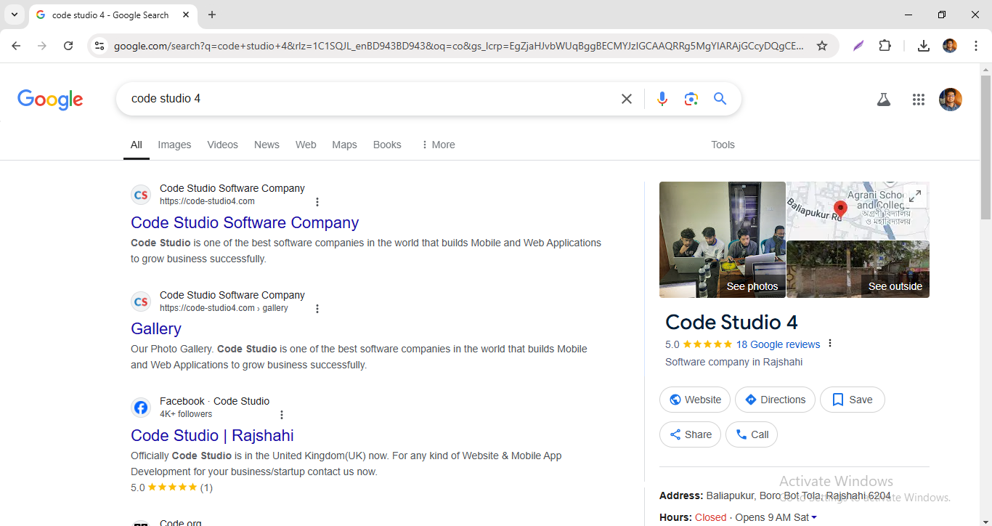
Soykot Hosen

Slide 6
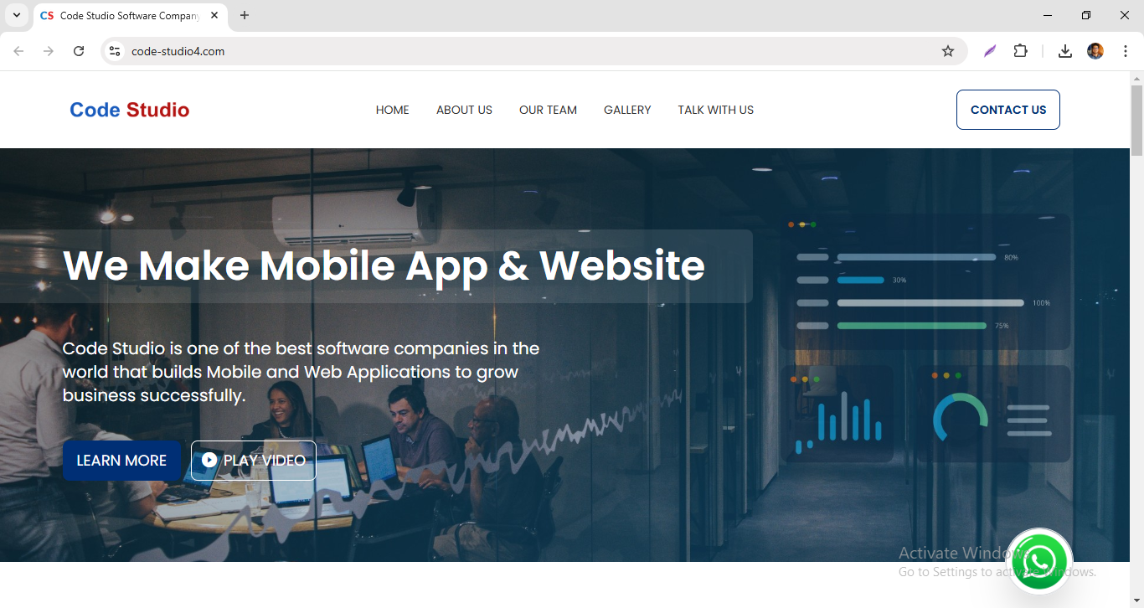
Soykot Hosen

Slide 7
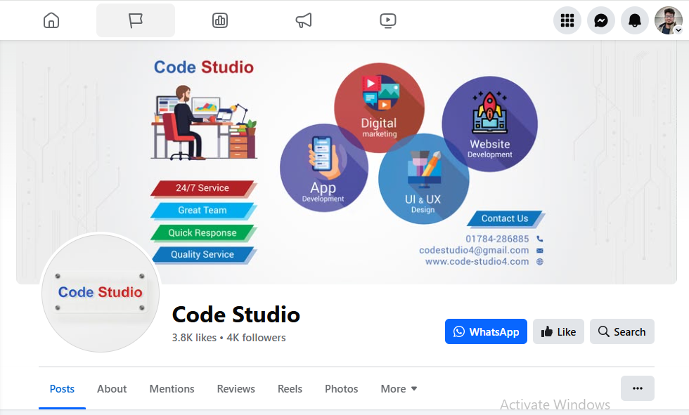
Soykot Hosen

Slide 8
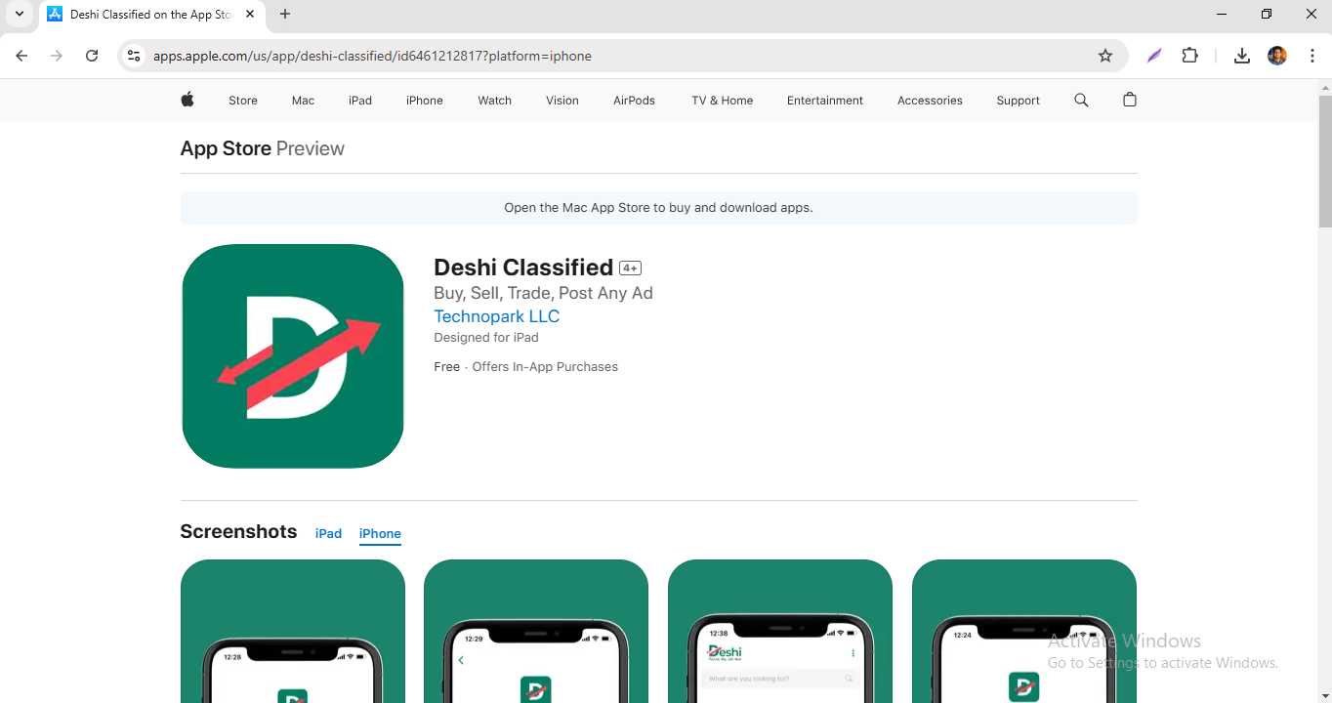
Soykot Hosen

Slide 9
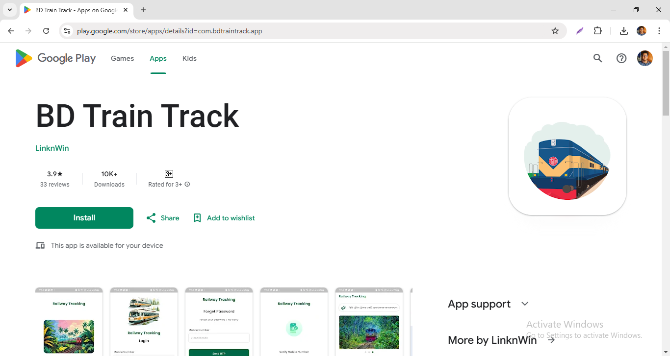
Soykot Hosen

Slide 10
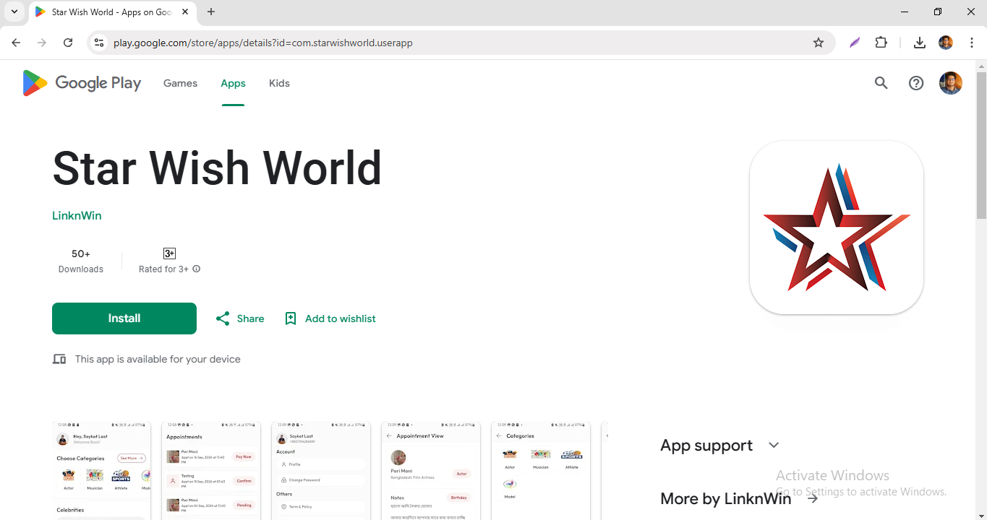
Soykot Hosen

Slide 11
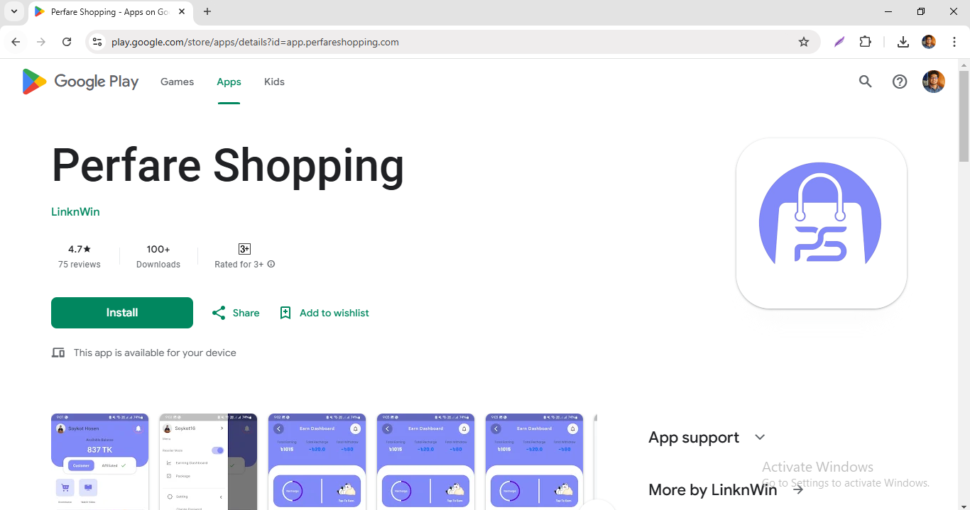
Soykot Hosen

Slide 12
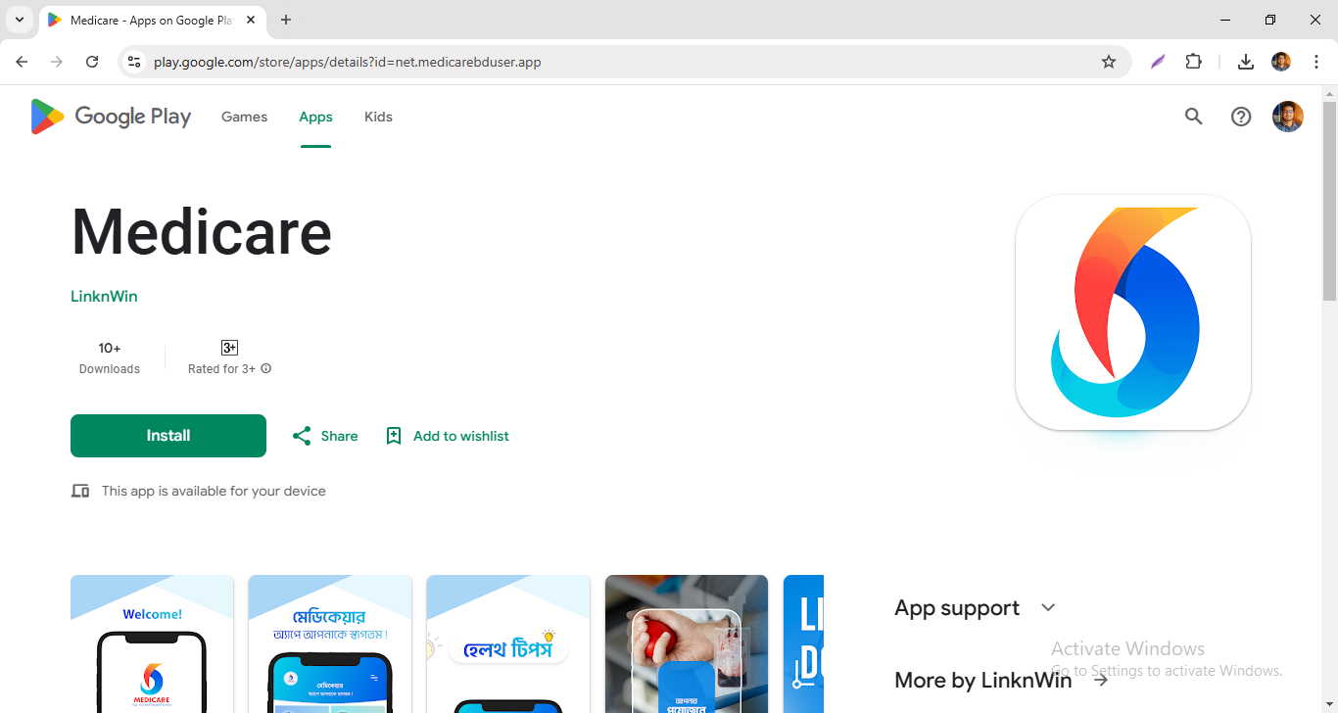
Soykot Hosen

Slide 13
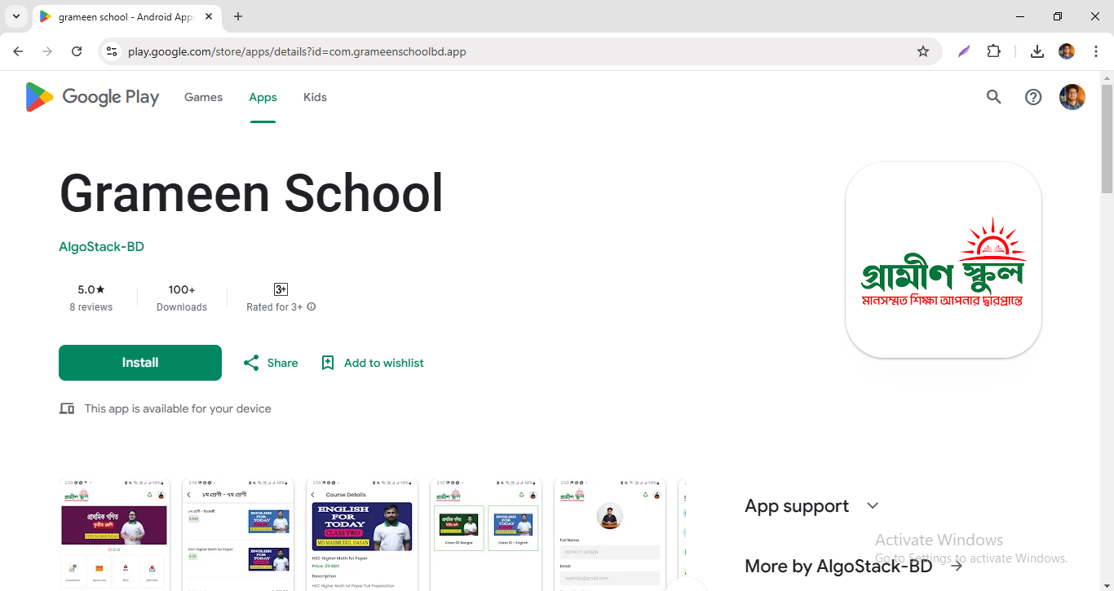
Soykot Hosen

Slide 14
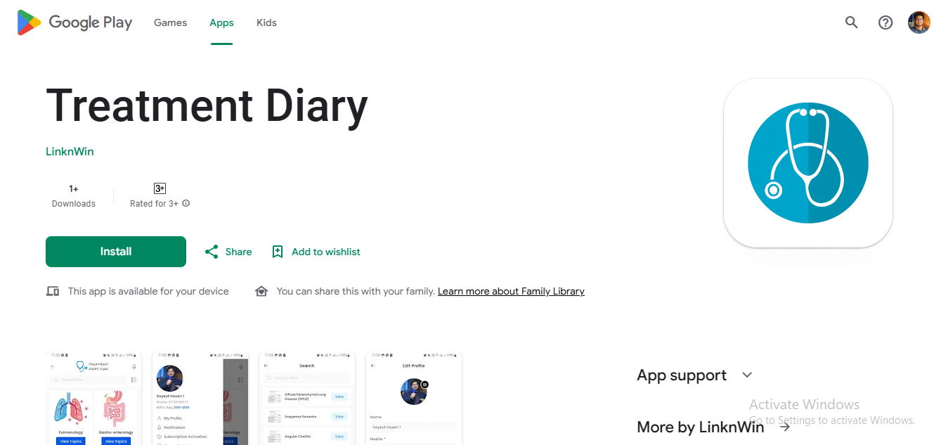
Soykot Hosen

Slide 15
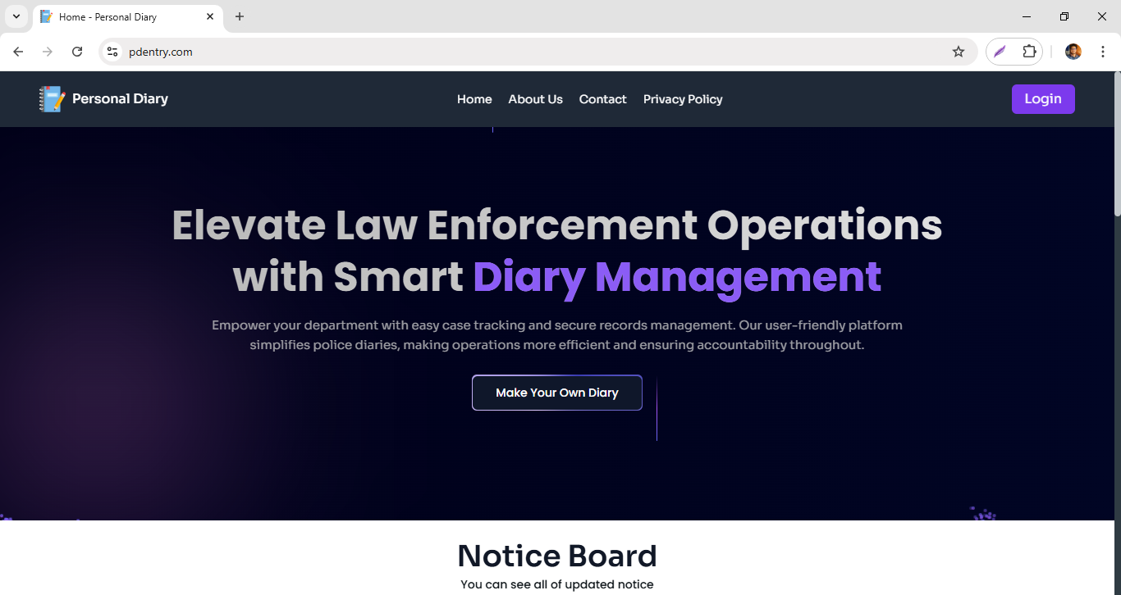
Soykot Hosen

Slide 16
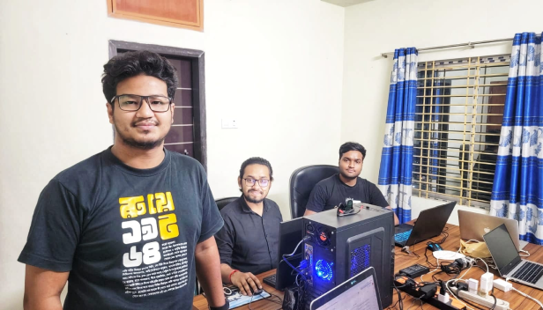
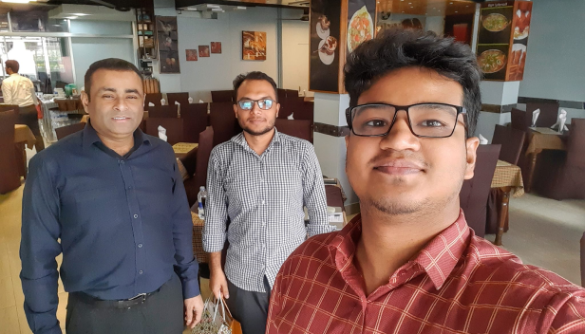
Soykot Hosen

Slide 17
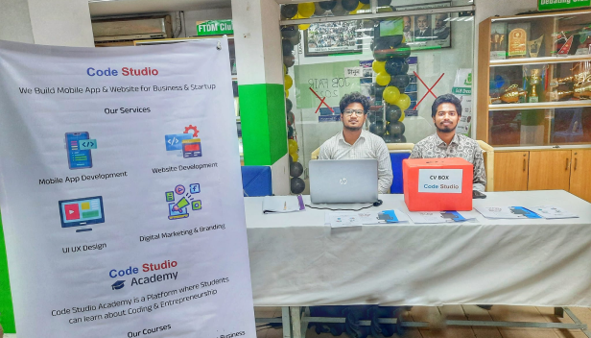
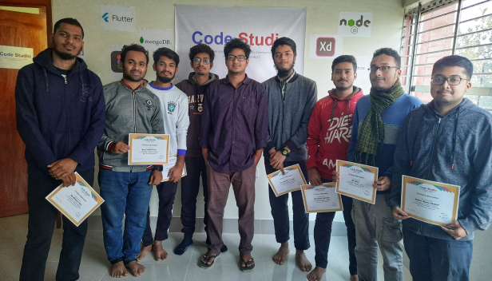
Soykot Hosen

Slide 18
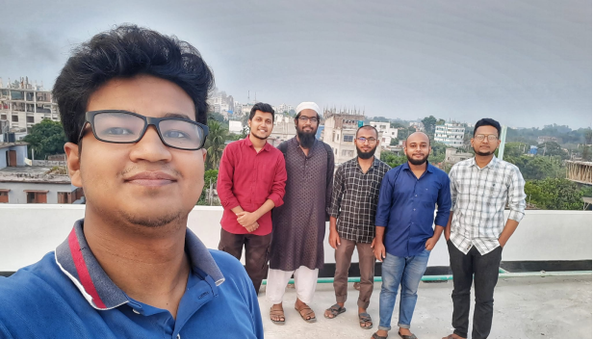
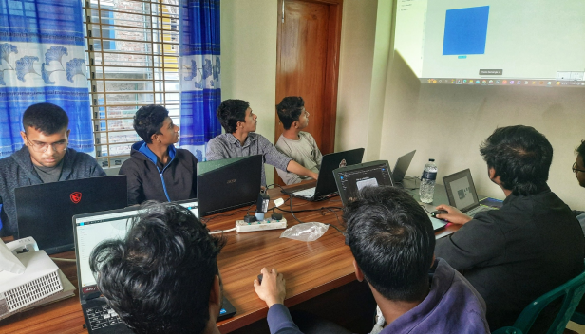
Soykot Hosen

Slide 19
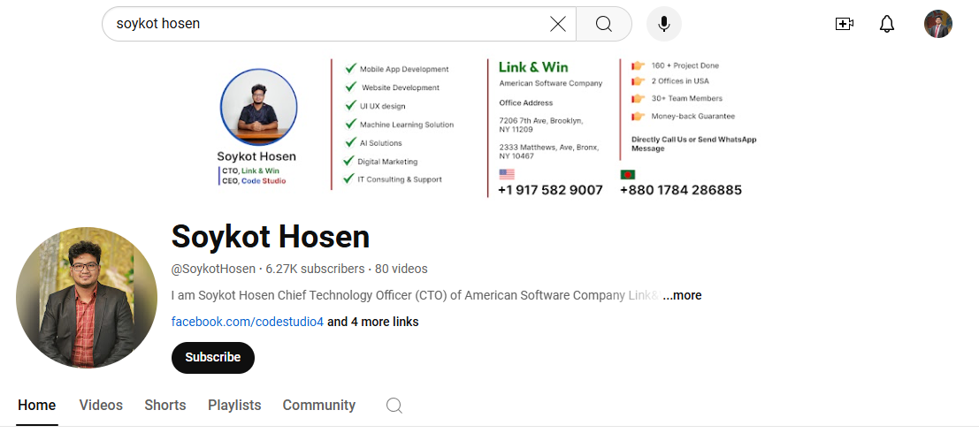
Soykot Hosen

Slide 20
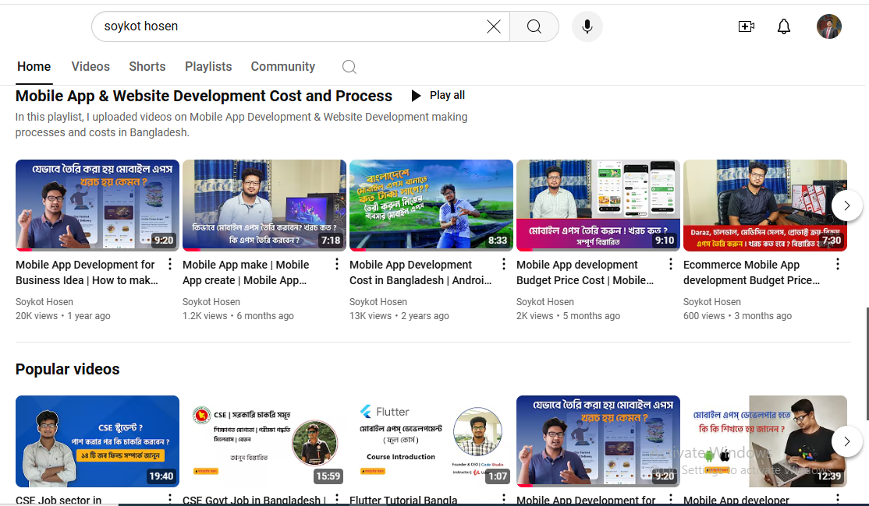
Soykot Hosen

Slide 21

Soykot Hosen
+880 1784 286885

Slide 22
Soykot Hosen
Thank You

